Slide 1

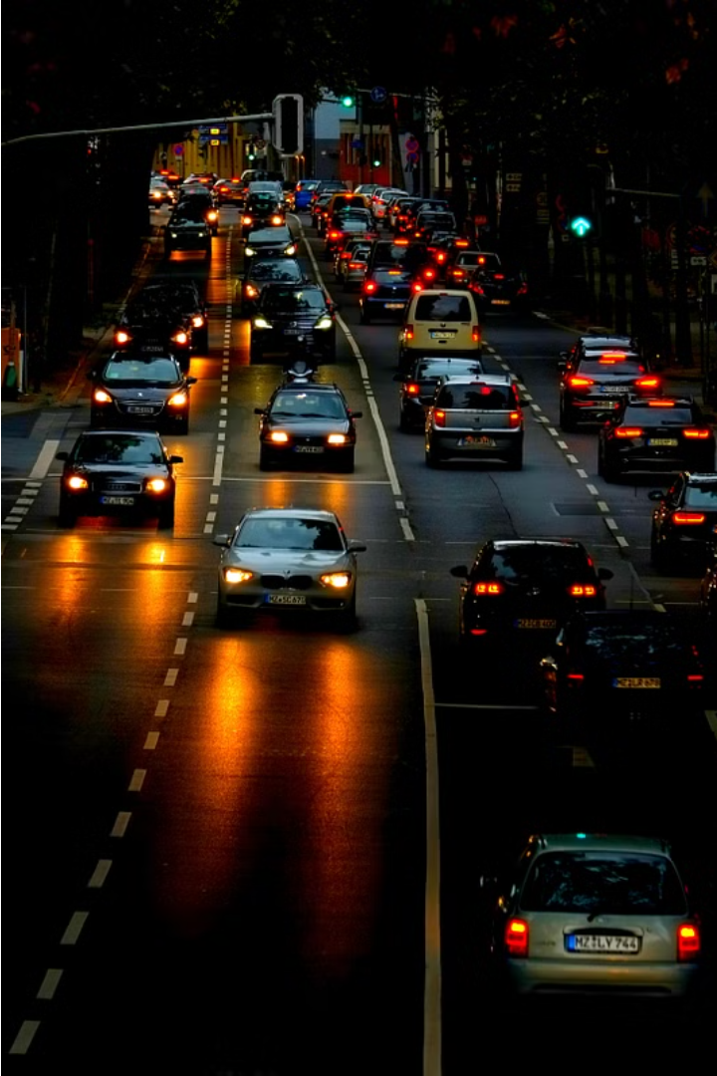
Number Plate Detection
Number Plate Detection (NPD) is a computer vision technology that automatically identifies and extracts vehicle registration plates from images or videos. This technology has a wide range of applications, including traffic management, law enforcement, and parking enforcement.

Slide 2
Architecture
Object Detection
Character Recognition
Post-processing
The first step in NPD is to detect the location of the number plate within an image using object detection algorithms like YOLO or Faster R-CNN.
Once the number plate is located, optical character recognition (OCR) is used to extract the individual characters on the plate.
Finally, the extracted characters are processed and formatted to output the complete license plate number.

Slide 3
Literature Survey
TITLE | YEAR PUBLISHED | AUTHOR NAME | METHODOLOGY | CONCLUSION
An Intelligent Lane and Obstacle Detection using YOLO algorithm | 2023 | Shalu1, Sonia Rathee*2, Amita Yadav3 | The Canny algorithm is utilized for edge detection, identifying the boundaries within the images. Subsequently, the Hough transform is applied to detect straight lines, which are indicative of lane markings. To enhance the system’s efficiency and meet real-time processing demands, a Region of Interest (ROI) is defined, effectively reducing noise and focusing on the relevant sections of the image. | he methodology combines the Canny edge detector for identifying edges, the Hough transform for line detection, and the YOLO algorithm for obstacle detection. The Region of Interest (ROI) is carefully defined to minimize noise and optimize processing speed, catering to the real-time demands of the system.
SC-YOLO: A Object Detection Model for Small Traffic Signs | 2023 | Yanli Shi; Xiangdong Li; Miaomiao Chen | The process begins with collecting a diverse set of road images, followed by image augmentation to enhance data variability. The YOLOv4 model is then tailored and trained on this dataset, focusing on lane line features. Post-training, the model’s detection capabilities are evaluated to ensure high accuracy and real-time performance, making it suitable for integration into driver-assistance systems. | The use of YOLOv4 for lane line detection likely demonstrates high accuracy and real-time processing capabilities, making it suitable for applications in advanced driver-assistance systems (ADAS). The model’s ability to detect various lane line types under different conditions can significantly contribute to the safety and efficiency of autonomous driving technologies.

Slide 4
TITLE | YEAR | AUTHOR | METHODOLOGY | CONCLUSION
Real-Time Vehicle and Distance Detection Based on Improved Yolo v5 Network | 2021 | Tian-Hao Wu; Tong-Wen Wang; Ya-Qi Liu | The methodology for the paper “Real-Time Vehicle and Distance Detection Based on Improved Yolo v5 Network” involves enhancing the YOLO v5 network’s capability to detect vehicles and their distances in real-time. The approach includes the use of the Flip-Mosaic algorithm to improve the network’s perception of small targets and reduce false detection rates caused by occlusion. | The conclusion drawn from the study indicates that the Flip-Mosaic data enhancement algorithm significantly improves the accuracy of vehicle detection. The experimental results demonstrate that this method not only enhances the detection of small targets but also contributes to a reduction in the false detection rate, making it a promising solution for real-time vehicle and distance detection applications

Slide 5
NLD using YOLO
1
Object Detection
2
Real-time Performance
3
Robust to Variations
YOLO divides the input image into a grid and predicts bounding boxes and class probabilities for each grid cell.
YOLO-based NPD can handle various challenges like plate orientation, lighting conditions, and partial occlusions.
YOLO is known for its fast processing speed, making it suitable for real-time number plate detection applications.

Slide 6
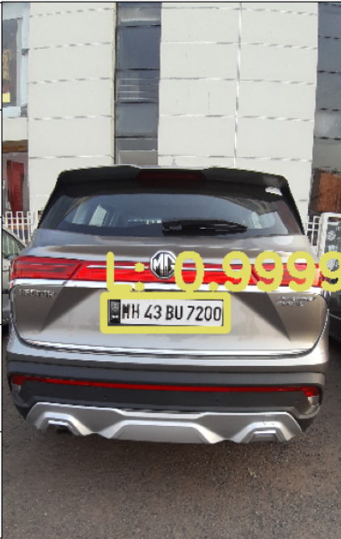
MODEL OUTPUTS USING YOLO DETECTION :

